Slide 1
Attendee-Sourcing
Anant Bhardwaj (MIT)
Juho Kim (MIT)
Steven Dow (CMU)
David Karger (MIT)
Sam Madden (MIT)
Rob Miller (MIT)
Haoqi Zhang (Northwestern)

Slide 2
A
design-space exploration
of
how to collect inputs
from
members with different roles in a community
to
solve real-world problems

Slide 3
CONFERENCE SCHEDULING
A Large Conference (CHI)
4 days
More than 500 papers
16 parallel sessions

Slide 4
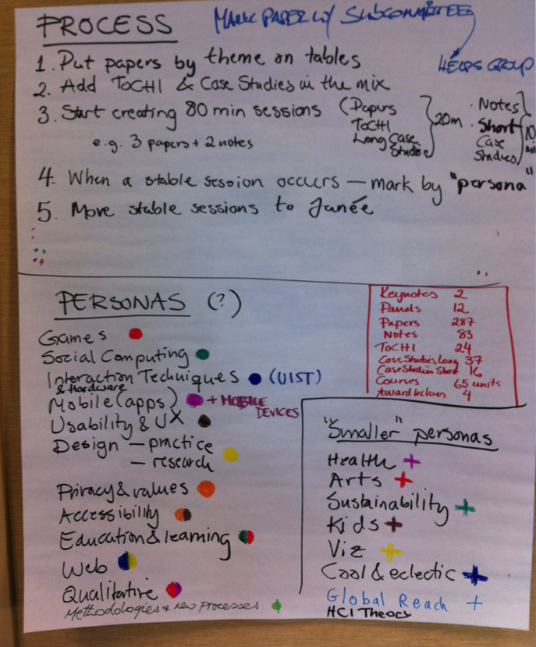
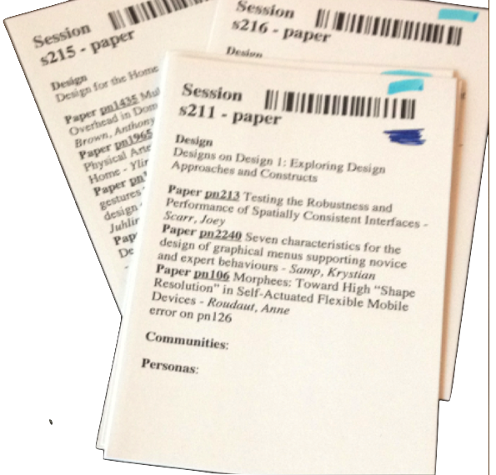
Paper Based Process

Slide 5
Notes:
The outcome of the process is a rough preliminary schedule created by program committees
The next step is to look at this rough schedule and further refine it.
Mainly resolve conflicts (don’t schedule two authors at the same time, don’t schedule two sessions-chairs same time, remove stray papers)

Slide 6
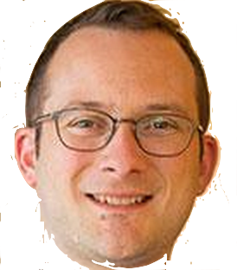
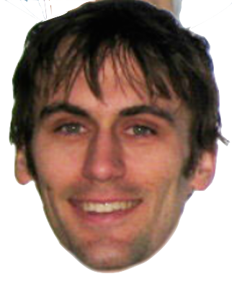


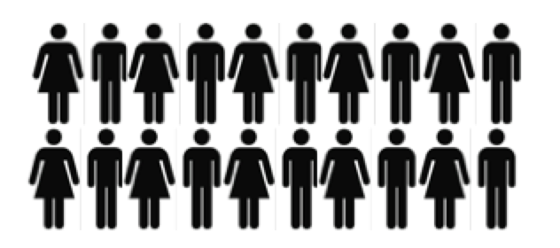
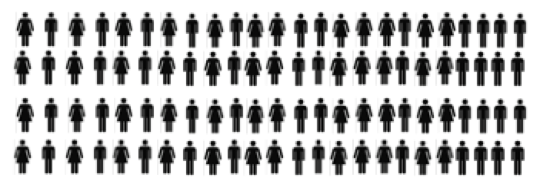
a Conference Community [HCOMP 2014]
Conference Chairs (2)
2. PC Members (31)
3. Authors (50+)
4. Attendees (200+)

Slide 7
Paper based process
Involved in the process
Chairs / Organizers
PC Members
Authors
Attendees

Slide 8
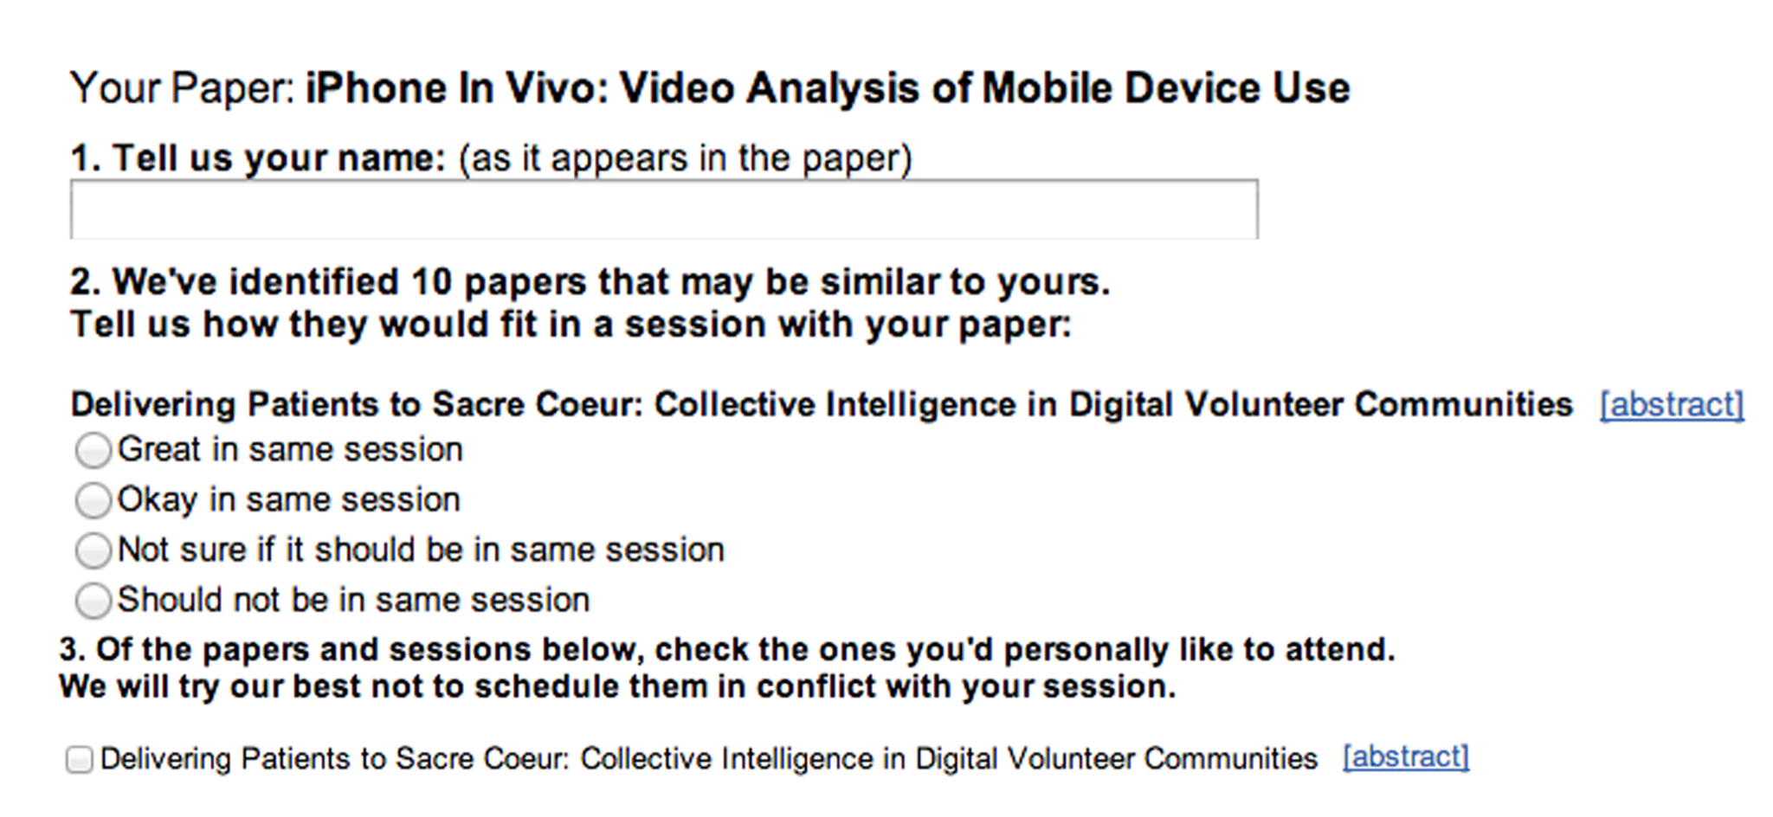
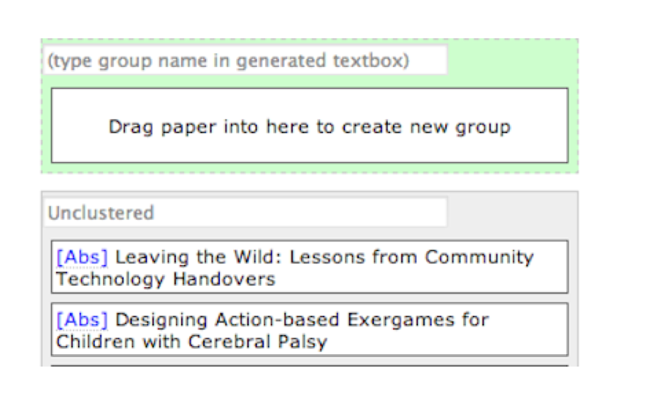
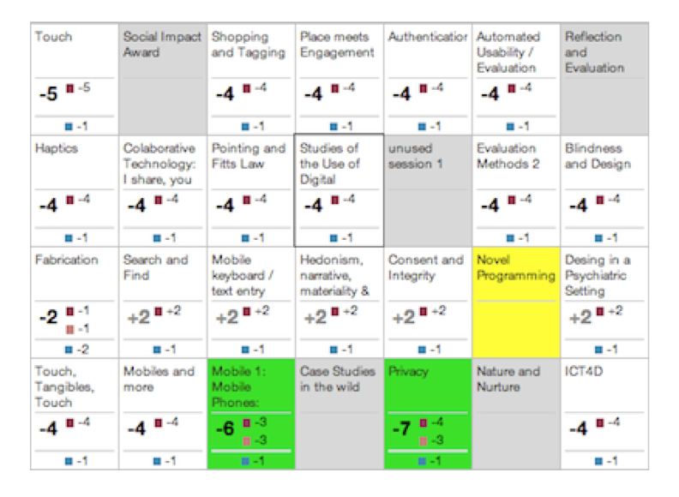
Prior Work [Cobi]
2. Author-Sourcing
Committee-Sourcing
3. Scheduling Interface

Slide 9
Cobi
Involved in the process
Chairs / Organizers
PC Members
Authors [partially]
Attendees
Research Question: Is there any benefit involving attendees in the process?

Slide 10
Attendee-Sourcing
Involve attendees -- collect useful data from attendees to help in conference scheduling.
CAVEAT
Attendees have no interest/incentive in helping in conference scheduling
PROPOSED SOLUTION
Give attendees a tool that they use for their own benefits and we collect useful data as a by-product of their usage of the tool.

Slide 11
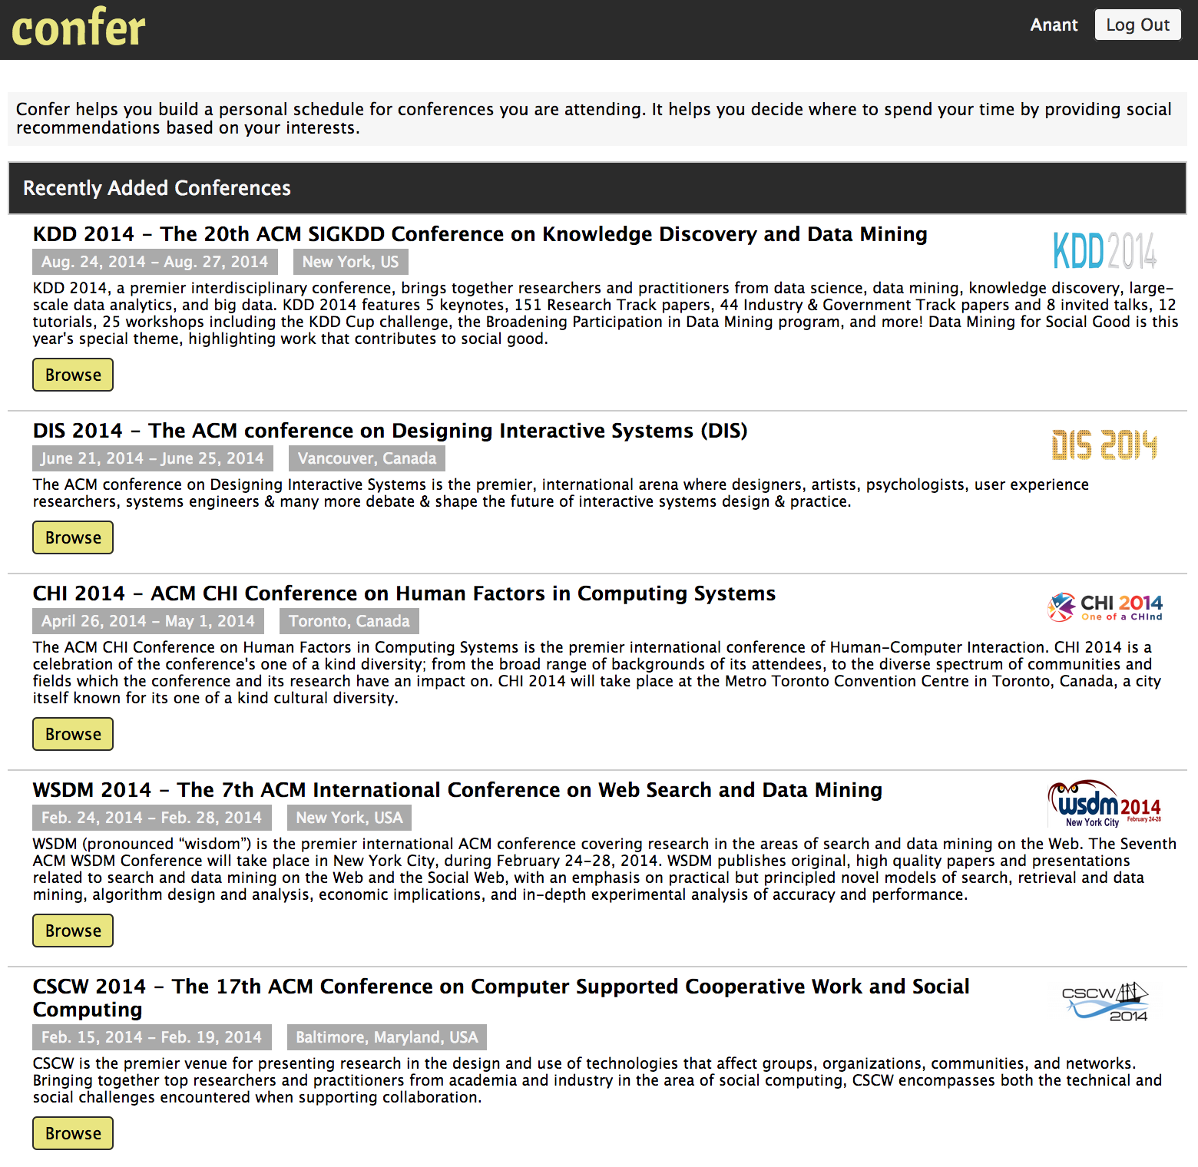
Introducing Confer [A tool for Attendee-Sourcing
Confer helps attendees find/explore interesting papers and build a personal schedule.

Slide 12
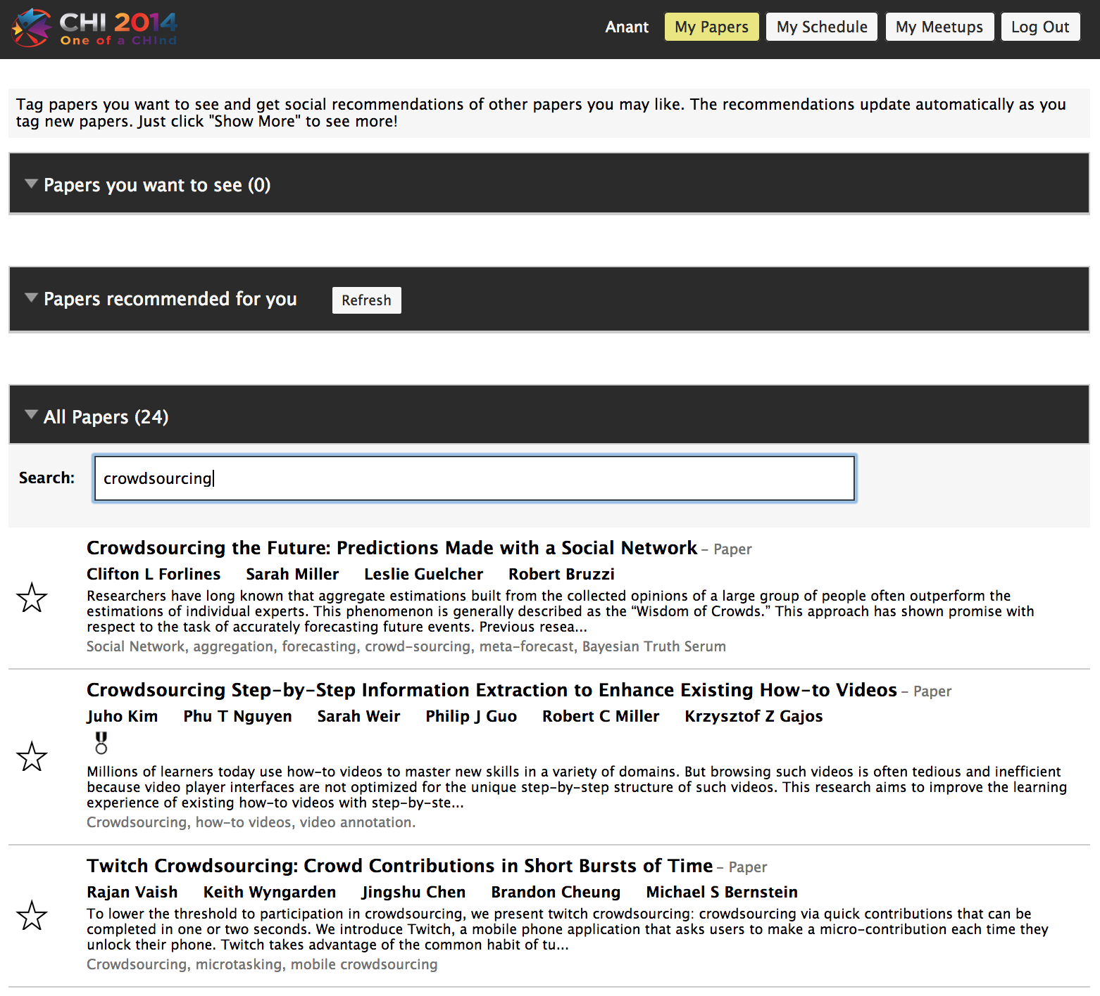
Attendees Search on Confer

Slide 13
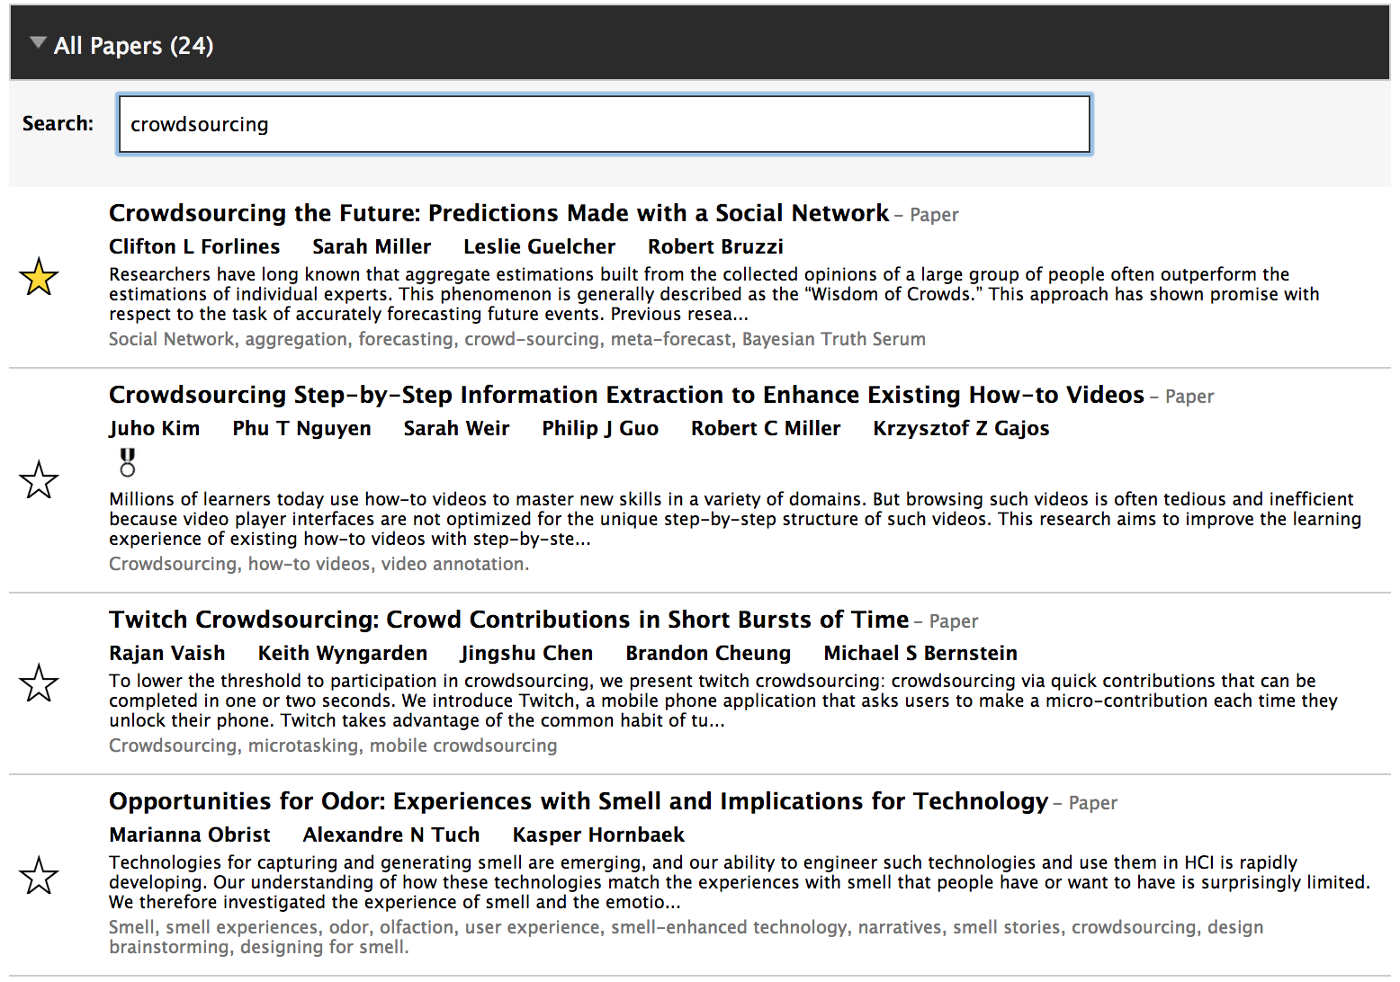
ATTENDEEES Mark Interesting Papers

Slide 14
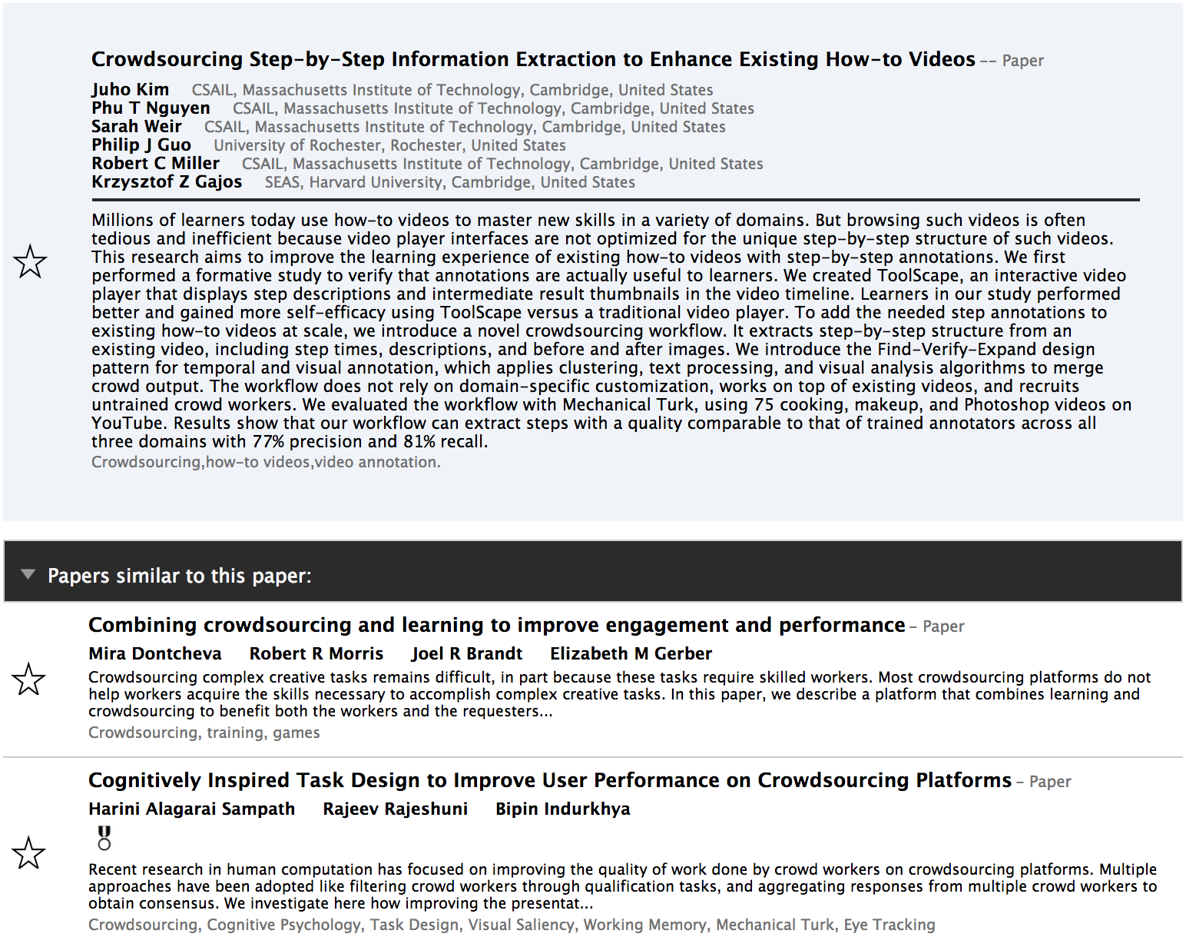
ATTENDEES EXPLORE

Slide 15
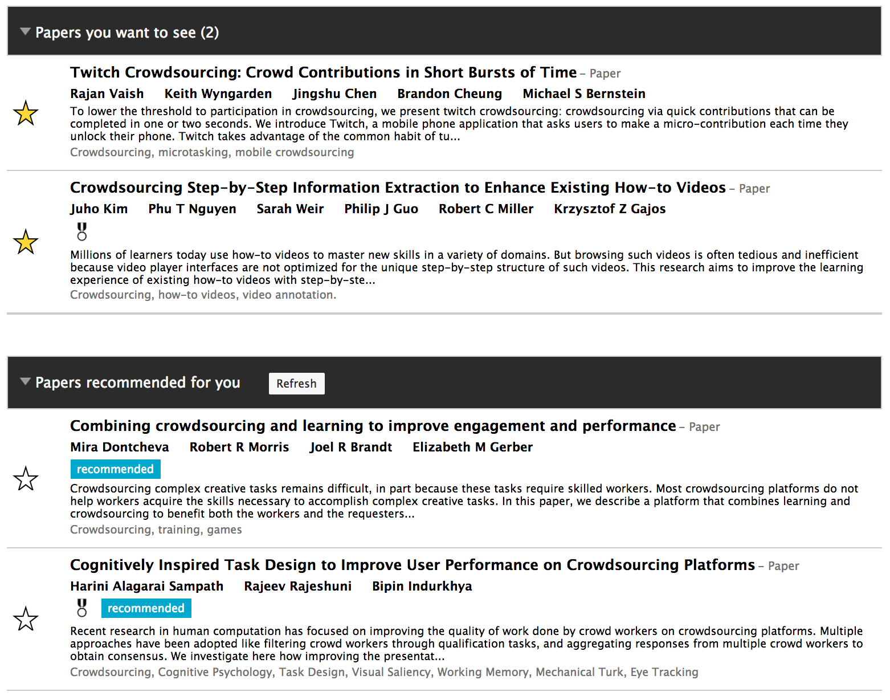
Confer Recommendations

Slide 16
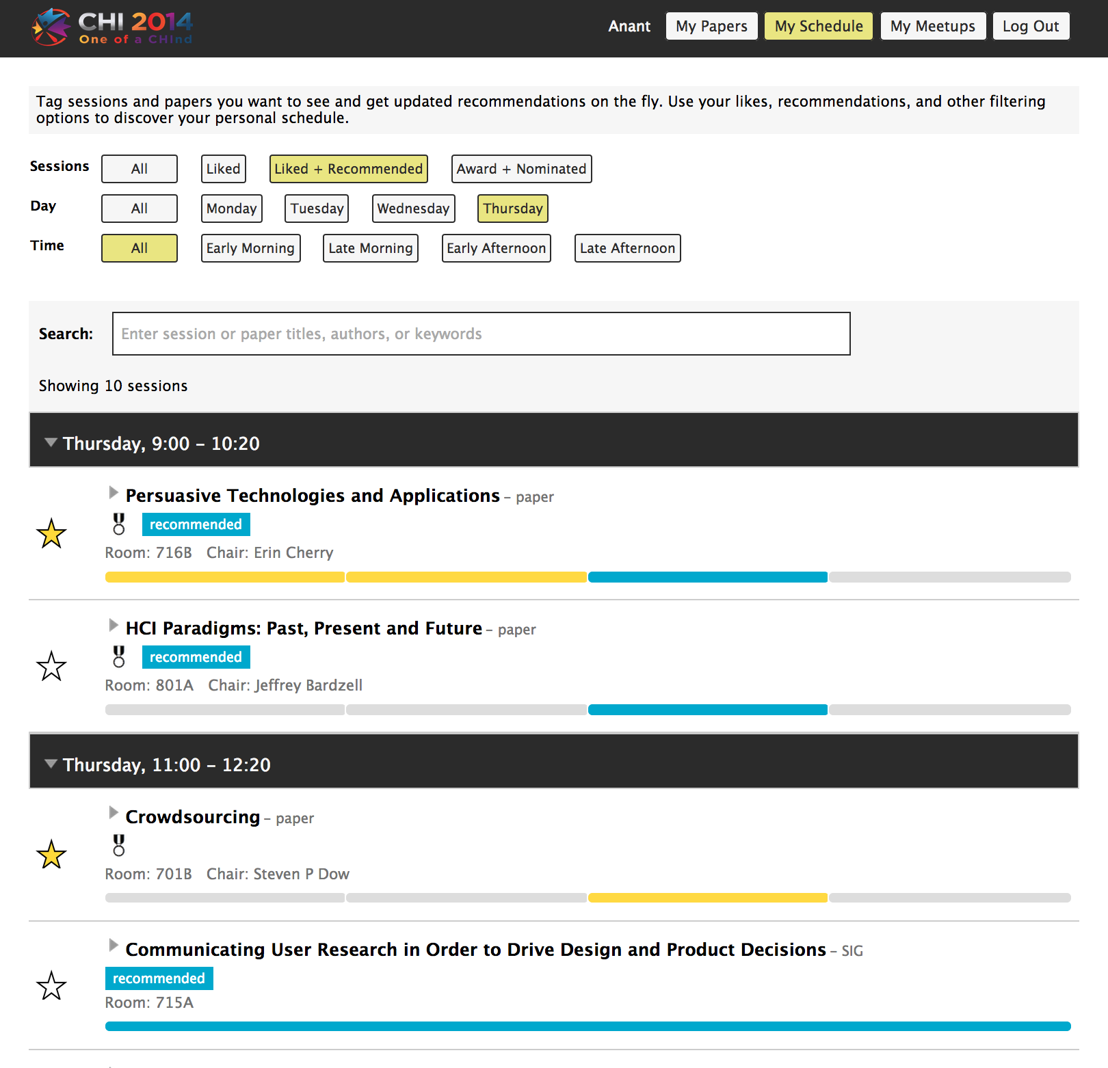
PERSONALIZED SCHEDULE

Slide 17
Attendee-Sourcing
Collect useful data from attendees to help in conference scheduling.
PROPOSAL
Use Confer to collect useful data from attendees.
CAVEAT
Why would attendee mark papers months in advance to help in conference scheduling?

Slide 18
Prior Knowledge
Based on Past Deployments of Confer
Attendees start using Confer immediately once the conference is available on Confer
They search for papers and explore related papers
While exploring, they add interesting papers to their preference list.

Slide 19
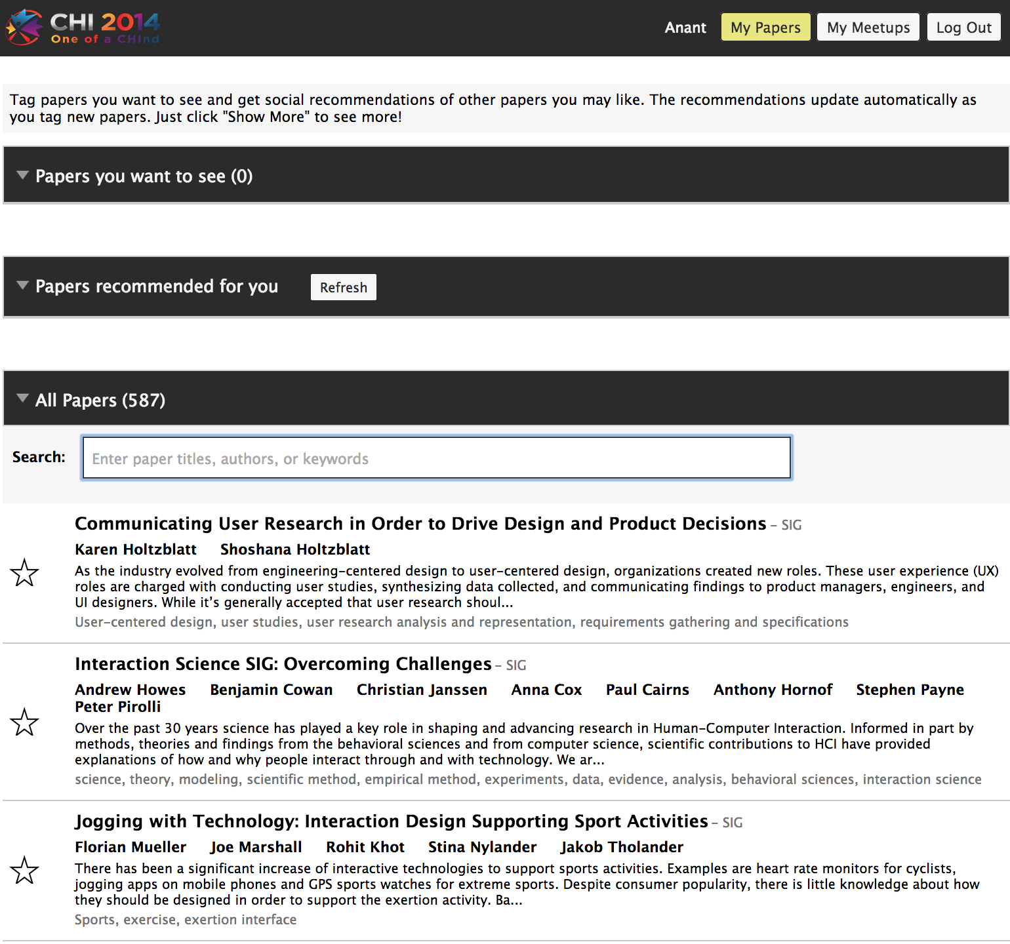
Attendee-Sourcing
No Schedule
60-90 days before the schedule announce-ment.
Notes:
So here is the idea: why not release the list of accepted papers as soon as you have them (without any schedule information) and hopefully, you will get enough data that can be useful for conference scheduling.

Slide 20
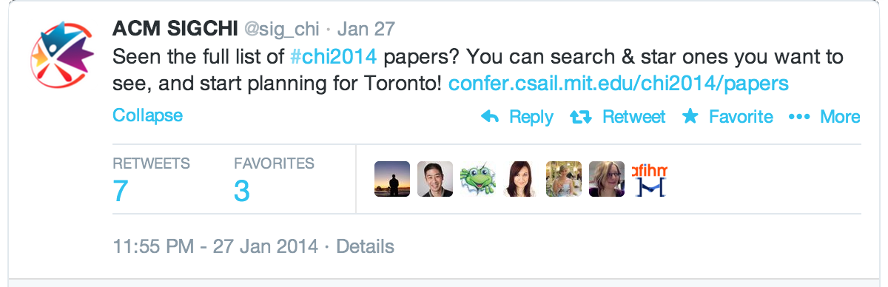
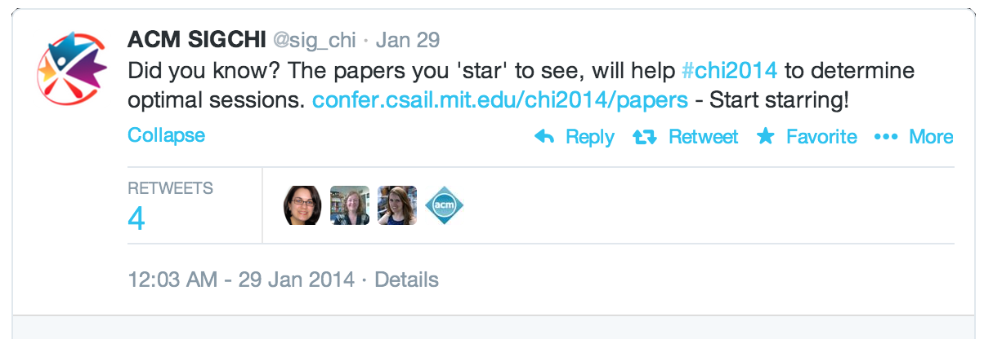
Advertise! Advertise!

Slide 21
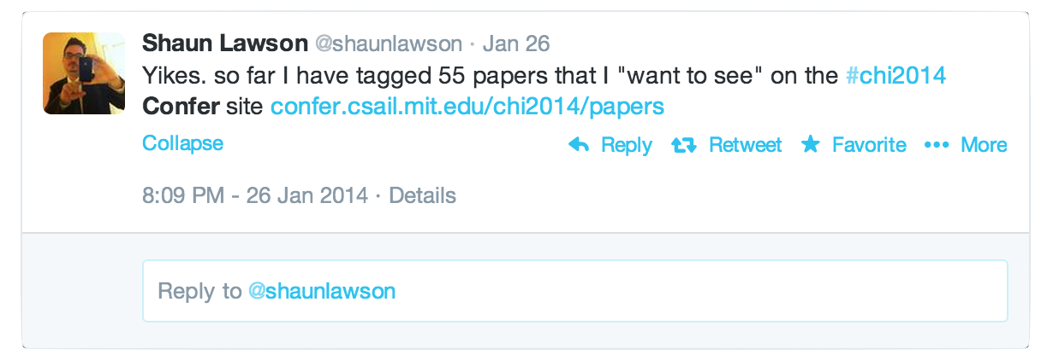
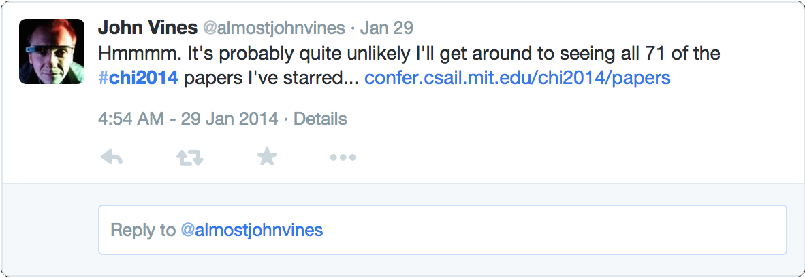
Rich Data (4 months in Advance)

Slide 22
RESEARCH QUESTION
Given that Cobi already collects preferences from authors, is there any benefit doing attendee-sourcing?

Slide 23
COBI vs. CONFER
Attendees want to see more papers
Confer (mean: 20.83, std-dev: 21.47, median: 14)
Cobi (mean: 6.1, std-dev: 3.86, median: 5)
Confer provides more coverage.
Confer (98.98%)
Cobi (91.14%)
Confer generates more preference data points, with less participation.
Confer (327 attendees: 7,228 preferences)
Cobi (634 authors: 3869 preferences)

Slide 24
PAPER SIMILARITY CAPTURE
0 pair
Confer: Strong Similarity.
Cobi: Weak or No Similarity
402 pairs:
Confer: Weak Similarity
Cobi: Strong Similarity.
150 pairs:
Confer: No Similarity (missed)
Cobi: Strong Similarity (discovered).

Slide 25
Nature of Data
Cobi validates similarity
High precision (cost: misses a lot on recall)
Confer discovers similarity
High recall (cost: some false positives)

Slide 26
Potential Biases
Author-Sourcing:
personal biases: my paper in a good session
Attendee-Sourcing
by-product of a natural exploration by attendees.
possible bias: social media, popularity

Slide 27
CHI 2014 [Confer + COBI]
CHI 2014 used data collected from both Cobi & Confer
Creating Sessions
a set of papers a lot of attendees want to see - same session.
Reducing Conflicts.
papers many attendees want to see: don’t schedule at the same time

Slide 28
Confer + Cobi
The data from Confer & Cobi complement each other.
Confer + Cobi
Chairs / Organizers
PC Members
Authors
Attendees

Slide 29
TAKEAWAYS
There is value in engaging all the community members
Different incentives, methods, and interfaces are needed for collecting data from different layers of a community.
Members with different roles and incentives produce data of different nature

Slide 30
Confer: Beyond Scheduling
Rooms
put popular papers in bigger rooms
Keynote speakers, panels, workshops, etc.
Understand trends, community network, etc.

Slide 31
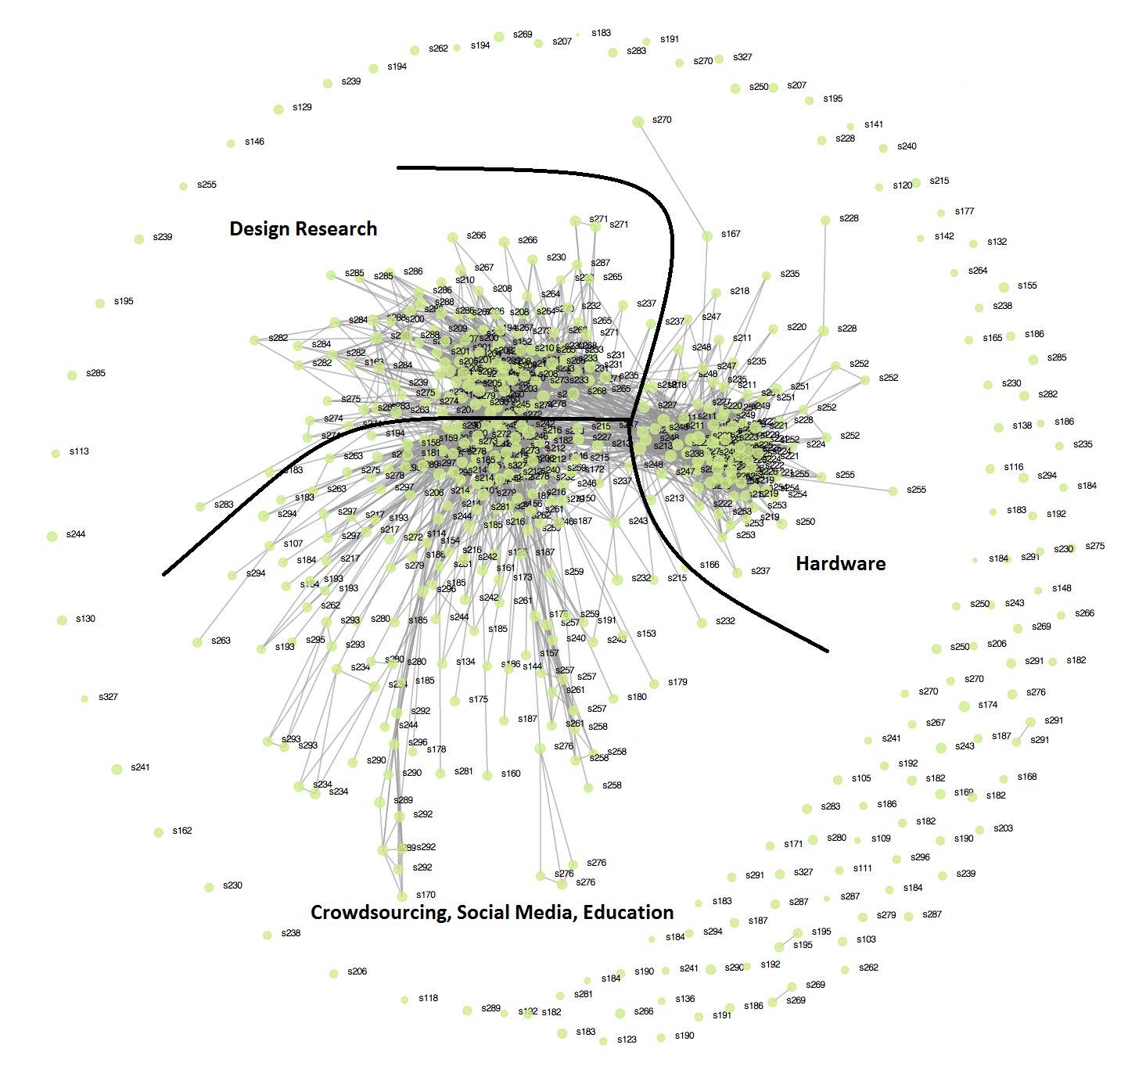

Slide 32
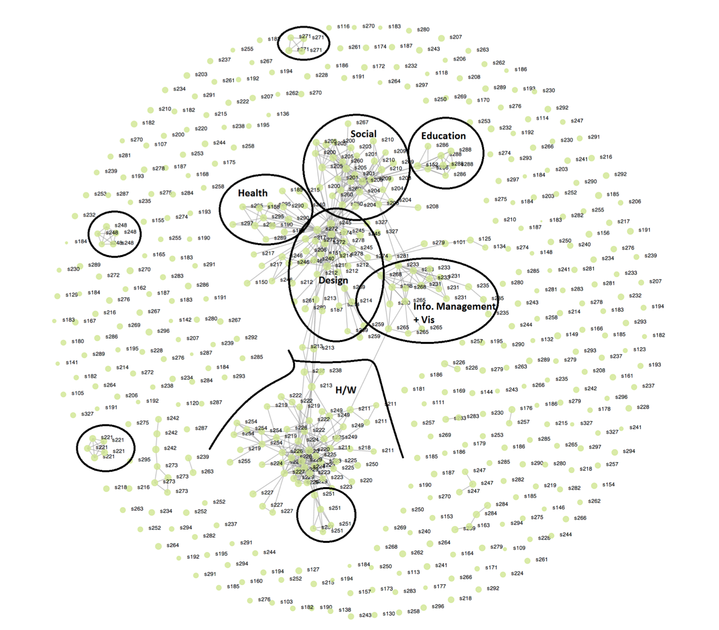

Slide 33
Summary
RESEARCH
A design-space (incentive & interface design) exploration of how to collect inputs from members with different roles in a community for solving real-world problems
A case study of collecting inputs from conference attendees for conference-scheduling
TAKEAWAYS
Different incentives, methods, and interfaces are needed for collecting data from different layers of a community.
Members with different roles and incentives produce data of different nature

